Slide 1
The make utility (original presentation courtesy of Alark Joshi)
Make is a utility that is included with
Linux/Unix operating systems
It is a command generator
It is designed to help you compile large projects

Slide 2
What is make?
Make is non-procedural
You tell make what you want (e.g. a particular class file or executable)
You provide a set of rules showing dependencies
between files
Make uses the rules to get the job done

Slide 3
Why use make?
For large programs, recompiling all the pieces
of the program can be very resource intensive
But if the program is complex, determining exactly what needs to be recompiled can be a time-consuming (and error-prone) task
The make utility was written to assist with this process

Slide 4
What does make do?
Make uses a file called Makefile (or makefile)
to determine what needs to be recompiled
Makefile contains a set of rules
When you run make, it uses the rules in the Makefile to determine what needs to be done
Make does the minimum amount of work
needed to get the job done

Slide 5
Rules in a Makefile
A typical rule has the form
target: dependency list
command list
target can be the name of a file that needs to be created (or a “phony” name that can be used to specify which command to execute)
The dependency list is a space separated list of files
that the target depends on in some way
The command list is one or more linux commands
needed to accomplish the task of creating the target

Slide 6
Rules in a Makefile
Each command must be indented with a tab
Both dependency lists and commands can be continued onto another line by putting a \ at the end of the first line
A # is used to start a comment in a makefile
– The comment consists of the remainder of the line

Slide 7
Example
Dependencies for a “list” program:
TestList.c includes List.h, Node.h, Job.h, and common.h
List.c includes List.h, Node.h, Job.h, and common.h
Node.c includes Node.h, Job.h, and common.h
Job.c includes Job.h and common.h

Slide 8
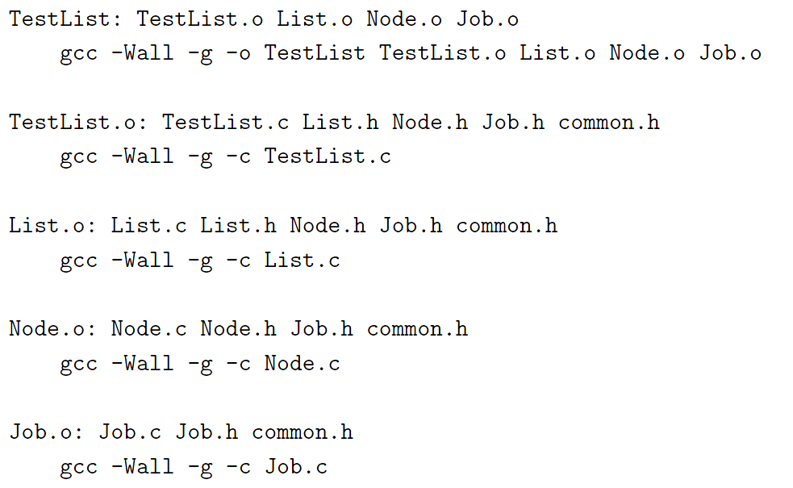
Rules for the “list” program
Brute-force approach

Slide 9
How make works
When you type make without a target name will assume you mean to make the first real target in the makefile
When you type make target, the make utility will look at the rule for target
make will recursively search through the rules for all the dependencies to determine what has been modified

Slide 10
How make works
If the current version of target is newer than all the files it depends on, make will do nothing.
If a target file is older than any of the files that it depends on, the command following the rule will be executed

Slide 11
Macros
Sometimes, you find yourself using the same stuff in lots of command actions---macros simplify things
Define macro
CC = gcc
CFLAGS = -O –Wall –g
PROGS = list TestList
Then use the macro by typing $(macroname)
$(CC) $(CFLAGS) –c List.c

Slide 12
# File "makefile" used to build "ola207" executable
CXX = g++ -std=c++11 –pedantic
ola207: bakery.o bakeryPrint.o
$(CXX) -g bakery.o bakeryPrint.o -o ola207
bakery.o: bakery.cpp bakeryPrint.h bakeryConstants.h
$(CXX) -g -c bakery.cpp
bakeryPrint.o: bakeryPrint.cpp bakeryPrint.h bakeryConstants.h
$(CXX) -g -c bakeryPrint.cpp

Slide 13
Phony Targets
Phony targets are targets that do not
correspond to a file
clean:
rm –f *.o

Slide 14
Example
all: subdirs
subdirs:
cd bad; make
cd almost-generic; make
cd generic-with-library; make
cd generic; make
clean:
cd | bad; make clean
cd | almost-generic; make clean
cd | generic-with-library/; make | clean
cd | generic; make clean

Slide 15
(Optional) Advanced Stuff follows:

Slide 16
Substitution Rules
Often, you will find that your Makefile has many
similar commands
You can use patterns to define rules and commands for such cases
For example, we could use the rule
%.o : %.c
$(CC) $(CFLAGS) –c $<
Which says that every .o file depends on the corresponding .c file and can be created from it with the command below the rule

Slide 17
Substitution Rules - Internal macros
% - any name (the same in all occurrences)
$@ - The name of the current target
$< - The first dependency for the current target
$^ - All the dependencies for the current target
%.o : %.c
$(CC) $(CFLAGS) –c $<
hello:
$(CC)
hello.o
$(CFLAGS)
$< -o $@

Slide 18
Suffix Rules
A suffix rule identifies suffixes that make should
recognizes
.SUFFIXES: .o .c
Another rule shows how files with suffixes are
related
.c.o :
$(CC) $(CFLAGS) –c $<
Think of this as saying the .o file is created from the corresponding .c file using the given command

Slide 19
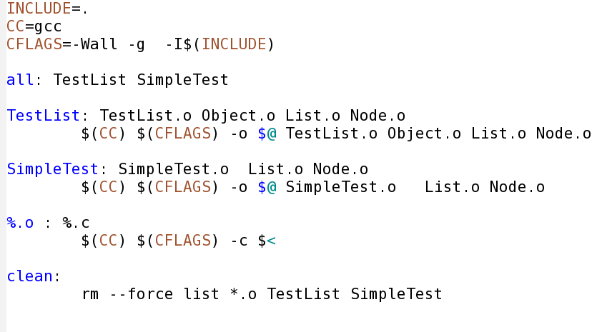
A More Advanced Example
With macros, suffix rules and phony targets

Slide 20
Taking the drudgery out of dependencies
Dependencies for a .o file should include all the
user written header files that it includes
For a big project, getting all of these right can take some time
The gcc command has an option -MMD which tells it to compute the dependencies.
These are stored in a file with the suffix .d
Include the .d file into the Makefile using
-include *.d

Slide 21
Multiple rules for a target
If there is more that one rule for a given
target, make will combine them.
The rules can be specified in any order in the
Makefile

